Slide 1
IE Organizational Building Leadership Program
Session 1: Defining Leadership for 2024 and Beyond
July 18, 2024

Slide 2
Agenda
Welcome and Introductions
Icebreaker: Identifying Your Passion & Pressure Point
The Nonprofit Landscape
The Core Pillars of Nonprofit Leadership
Develooing Your Leadership Manifesto
Upcoming Sessions
Final Reflections

Slide 3

Veronica Vazquez
(She/Her)
Corporate Philanthropy Advisor
Southern California Edison (SCE)
Notes:
Cedars Welcome

Slide 4
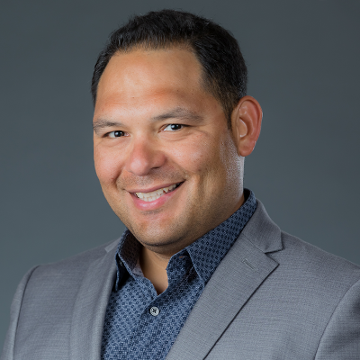
Efrain Escobedo
(He/Him)
President & CEO
Center for Nonprofit Management
Notes:
Cedars Welcome

Slide 5
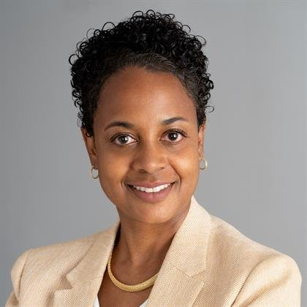
Session 1 - Facilitator
Sandra J. Hill-Glover, Ed.D., MSW
(She/Her)
Vice President, Learning & Innovation
Center for Nonprofit Management
shillglover@cnmsocal.org
Notes:
Facilitator Intro

Slide 6
Group Agreements
Be present
Participate – interaction
Step up/back
Listen without judgement
Share the message, not the messenger
Talk from your experience
Be open to new ideas
Learn from each other
Be respectful with electronics

Slide 7
Ice Breaker
Share your Passion
Share Your Pressure Point(s)

Slide 8
The IE Nonprofit Landscape
Notes:
Part 1

Slide 9

(Nonprofits) give shape to our boldest dreams, highest ideals, and noblest causes. America’s 1.3 million charitable nonprofits feed, heal, shelter, educate, inspire, enlighten, and nurture people of every age, gender, race, and socioeconomic status, from coast to coast, border to border, and beyond. They foster civic engagement and leadership, drive economic growth, and strengthen the fabric of our communities.
Every single day.

Slide 10
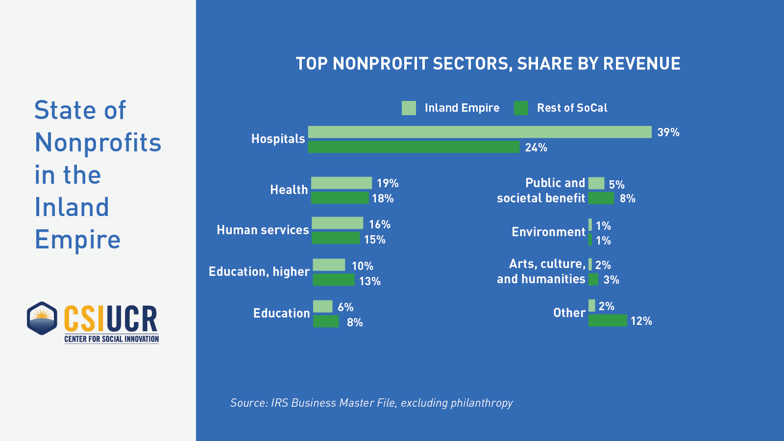

Slide 11
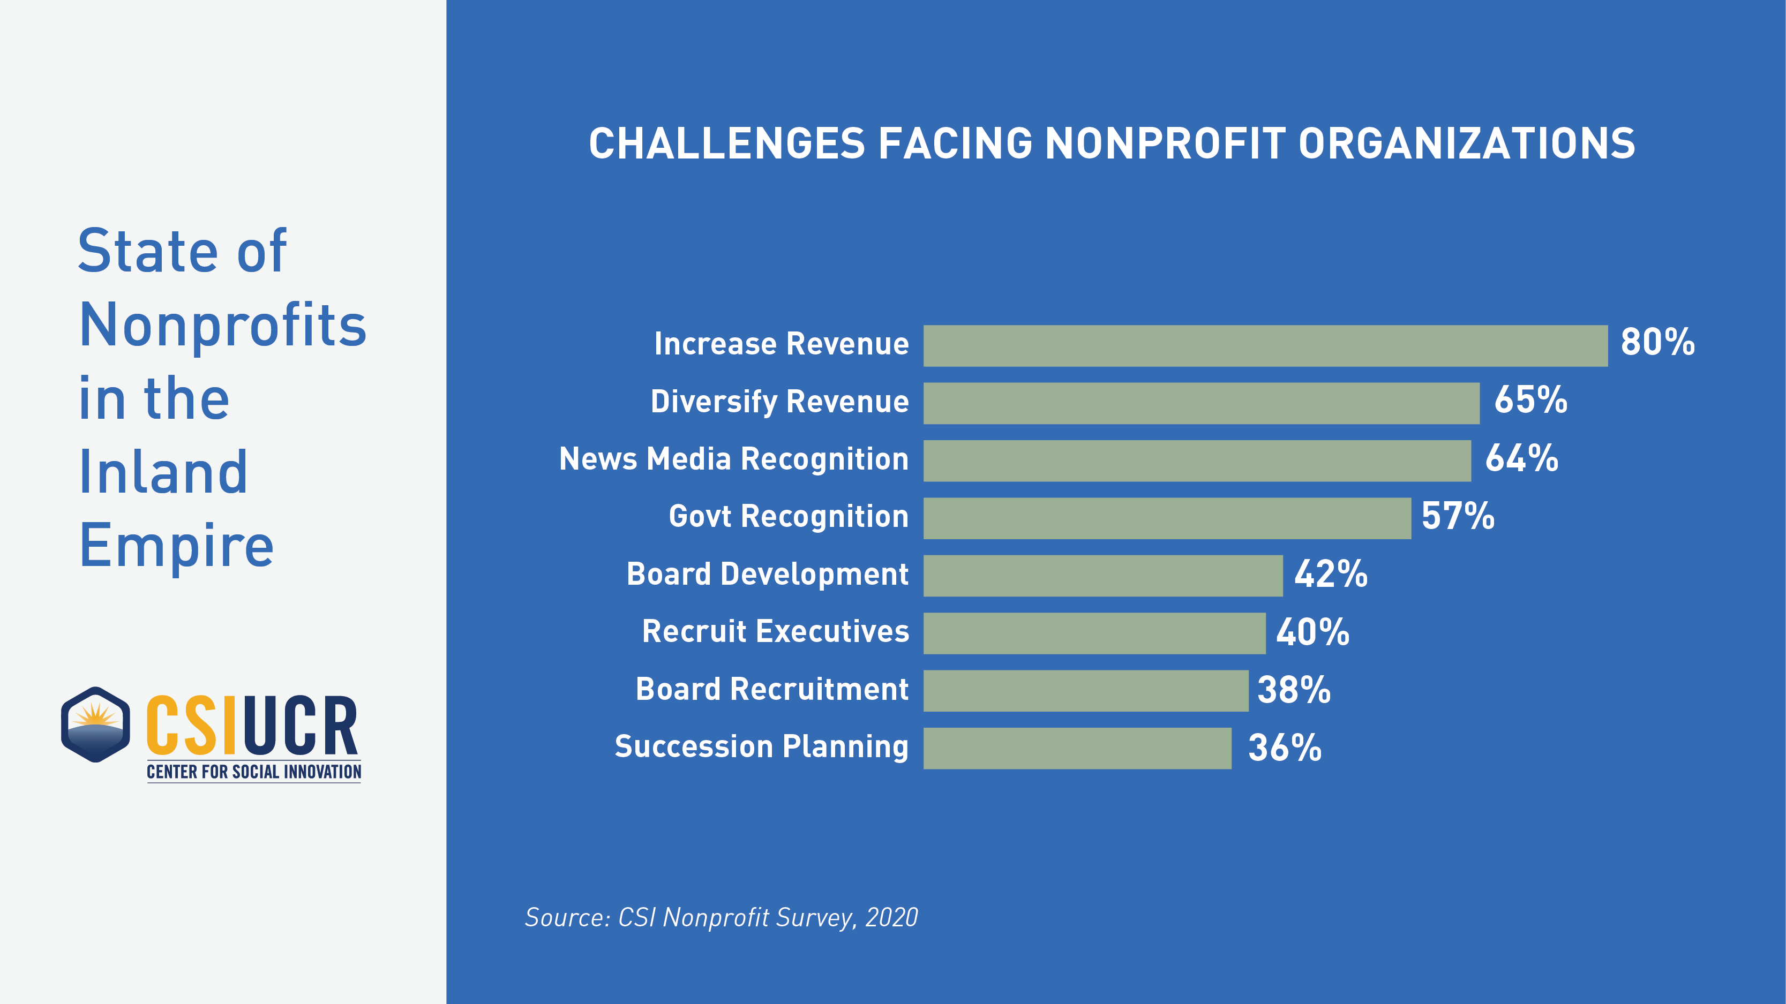

Slide 12
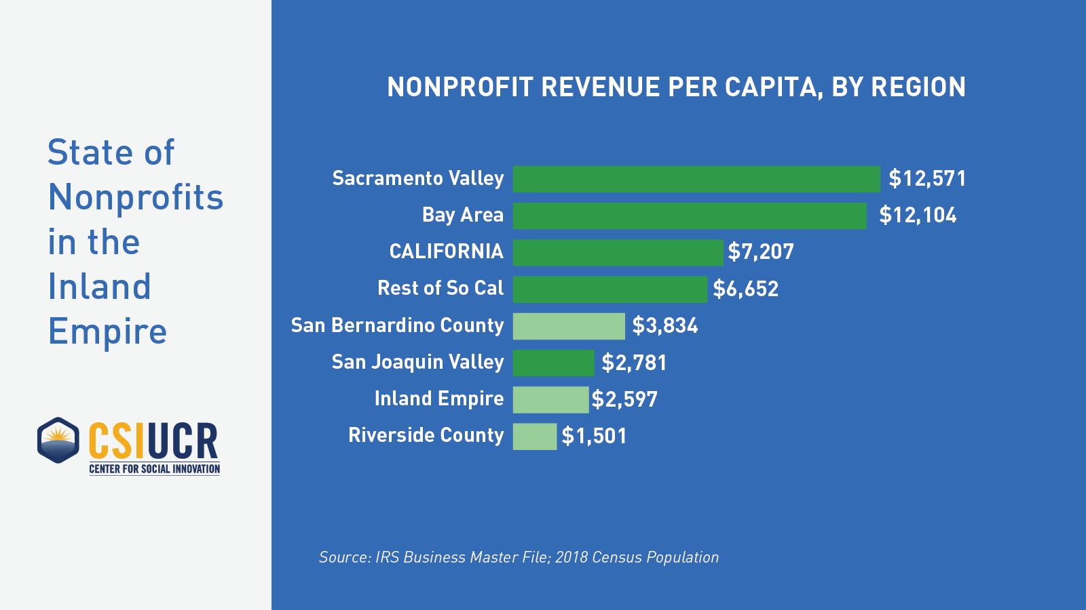

Slide 13
The Core Pillars of Nonprofit Leadership

Slide 14
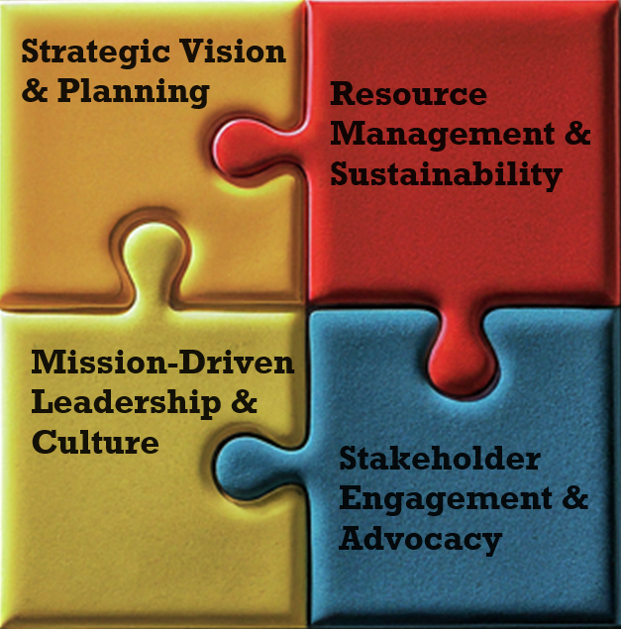
The Four
Core Pillars

Slide 15
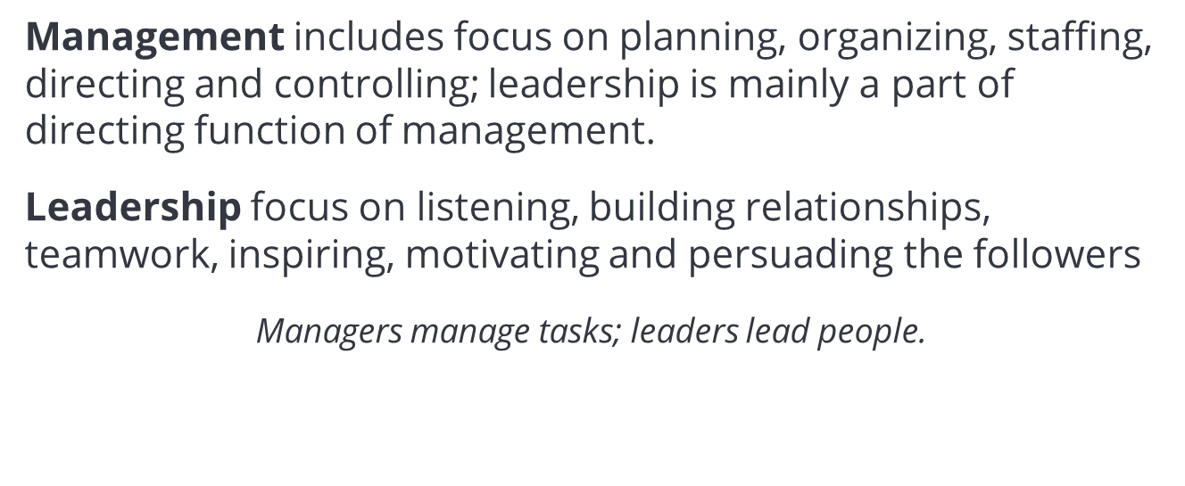
Leadership and Management: A Contrast

Slide 16
Changing Paradigms Of Leadership
Traditional Paradigm
Emergent Paradigm
Provides Vision
Provides Answers
Great Individual
Leaders
Full Authority
Competition
Hierarchical
Cultivate a Shared Sense of Purpose
Shape a Learning Community
Develop Leadership in Individuals and Groups
Emphasize Collaboration
Lateral Relationships
Notes:
16

Slide 17
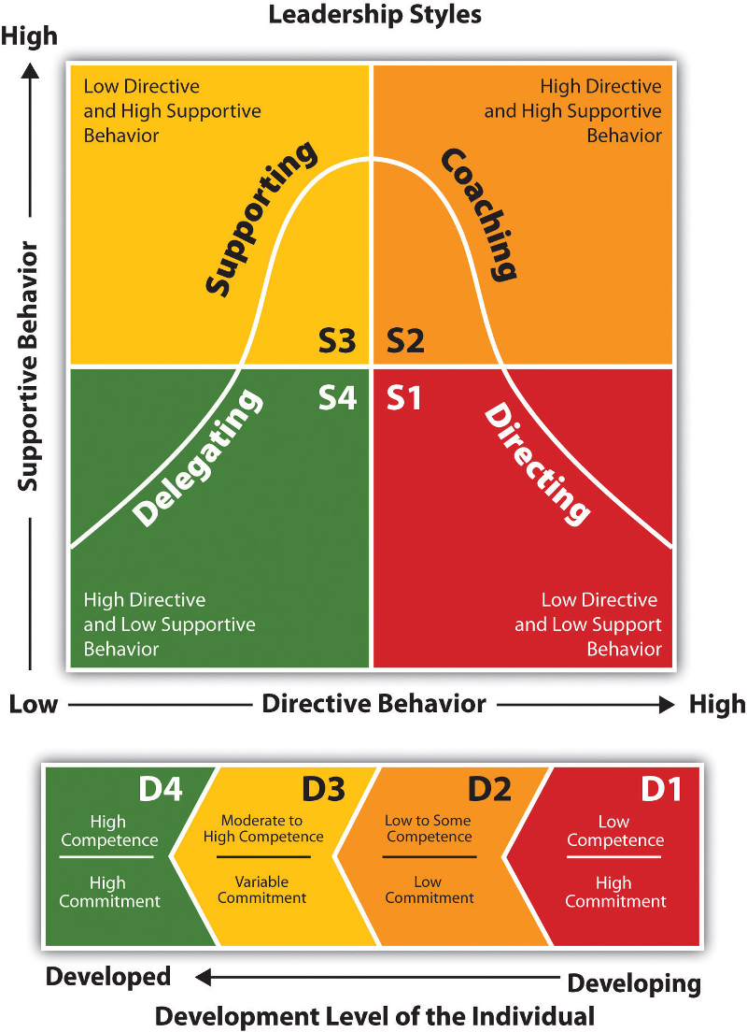

Slide 18
BREAK TIME
15 MIN

Slide 19
The Grounded Leader

Slide 20
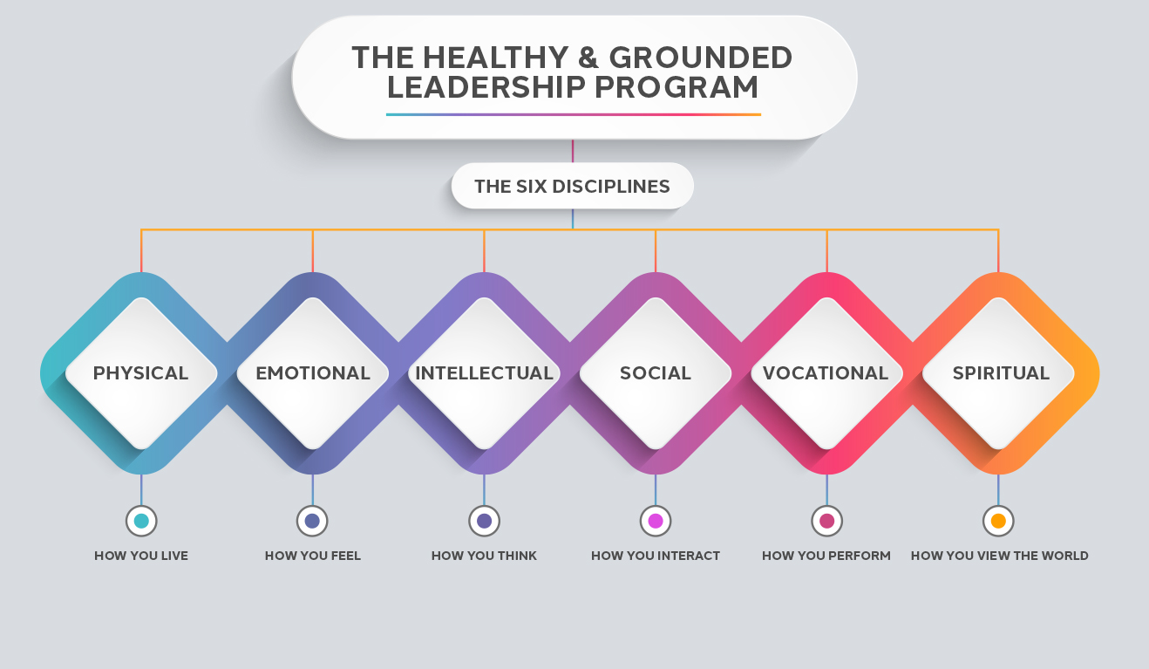

Slide 21
The Leadership Manifesto

Slide 22
Developing a leadership manifesto is a journey of self-discovery and a powerful tool for guiding your actions.

Slide 23
BREAKOUT SESSION
Developing Your Leadership Manifesto

Slide 24
Developing Your Leadership Manifesto: Guided Self-Reflection
Identify Your Core Values
Define Your Leadership Style
Make Meaning of Your Leadership Philosophy

Slide 25
Upcoming Sessions

Slide 26
Date | Session Topic
Aug 8 (Virtual) | Leveraging your Identify as a Leader - Understanding Culture and your Identity
Aug 29 (Virtual) | Fostering Organization and Individual Resiliency
Sept 19 (Virtual) | Traits of Highly Effective Organizations
Oct 10 (In-Person) | Implementing Succession Planning for Sustainable Organizations

Slide 27
Final Reflections

Slide 28

Questions?
28

Slide 29
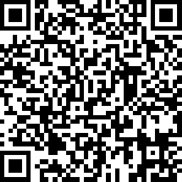

Please complete our seminar evaluation
Session1 (July 18): Defining Leadership in 2024 and Beyond
Main Instructor: Sandra Hill-Glover
29

Slide 30
Next session:
August 8: Leveraging your Identify as a Leader - Understanding Culture and your Identity
30

